Slide 1


THE FUTURE DIRECTIONS AND CHALLENGES OF PHILIPPINE EDUCATION
20TH ANNIVERSARY AND MID-YEAR CONVENTION 2023
Philippine Association for Teachers of Educational Foundations – United Professionals for the Development & Advancement of Teacher Education (PATEF-UPDATE), Inc.
May 18, 2023 | Century Park Hotel

Slide 2
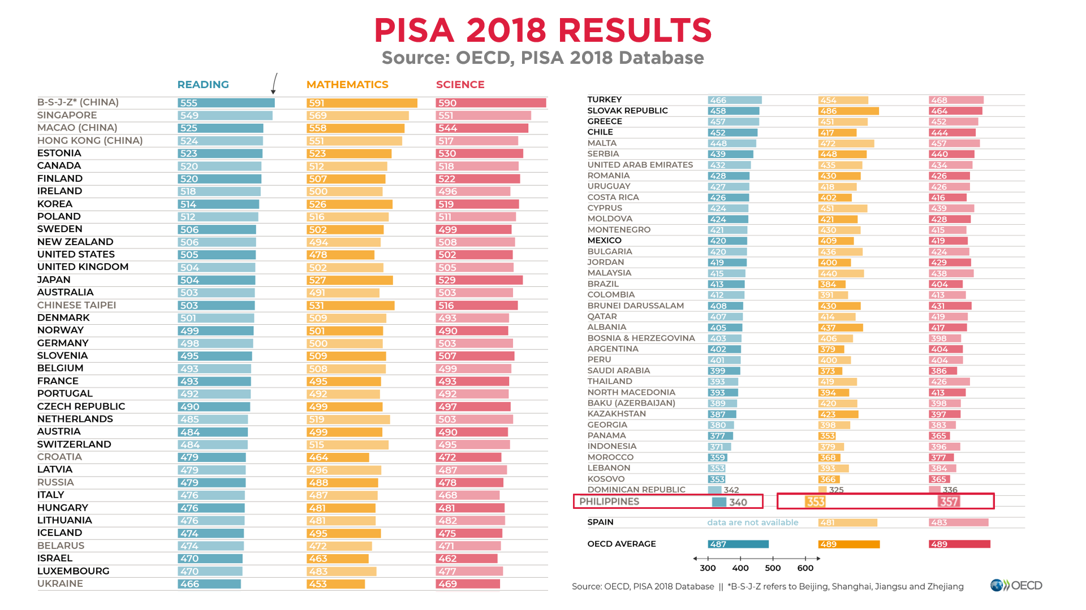
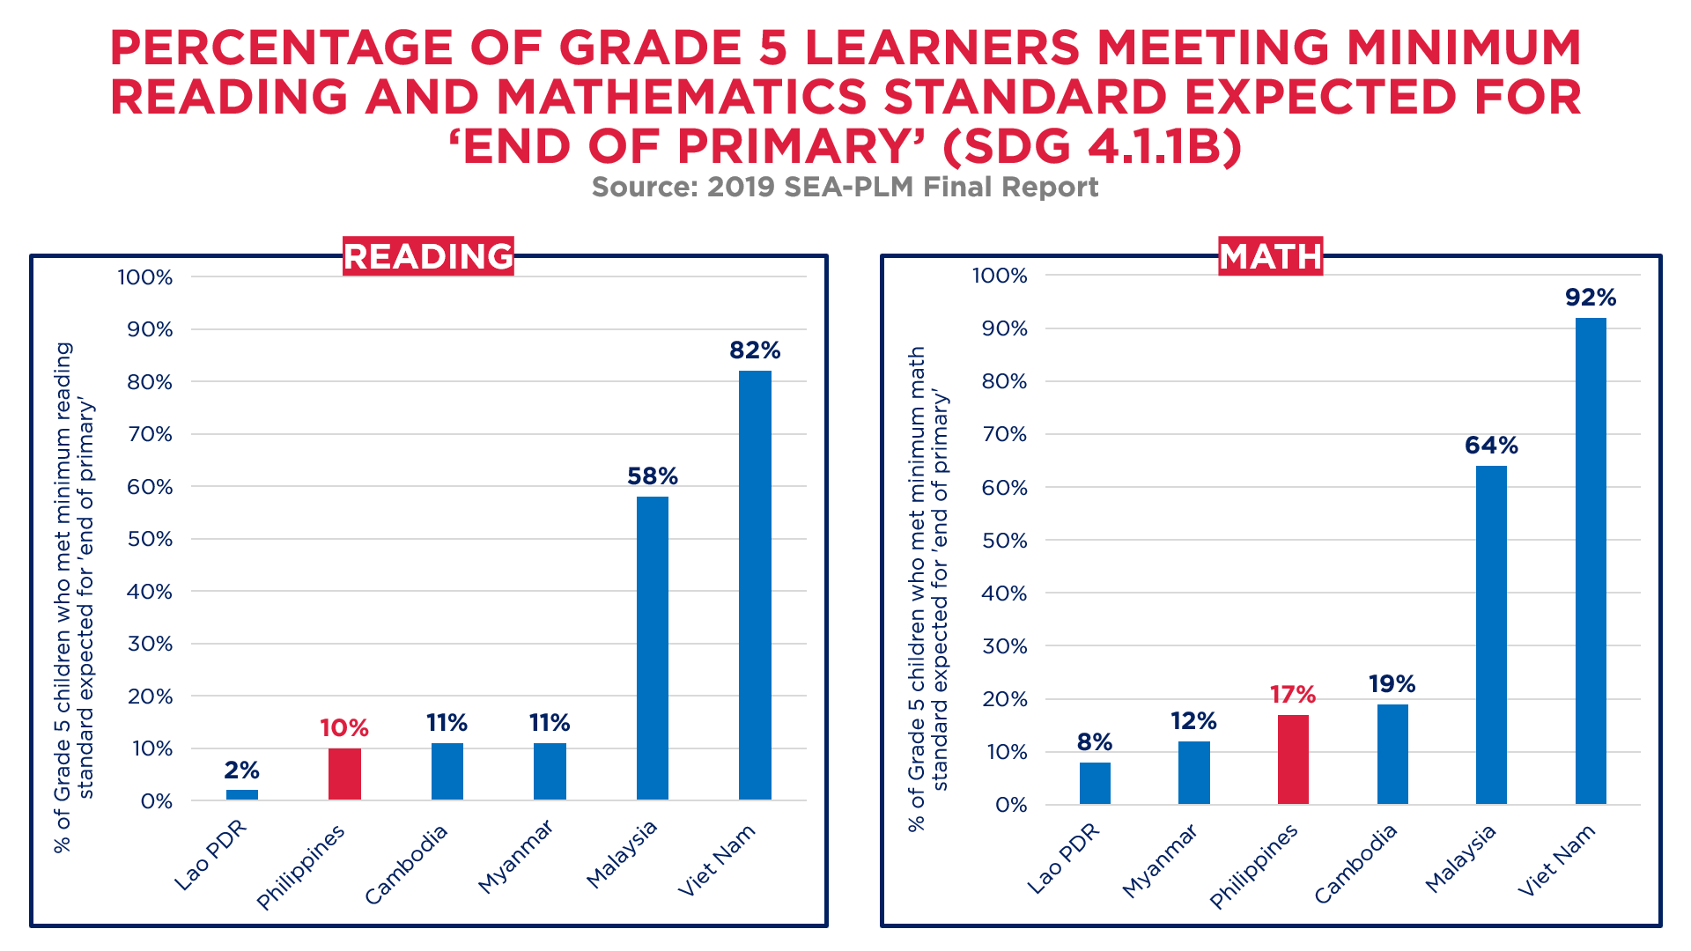
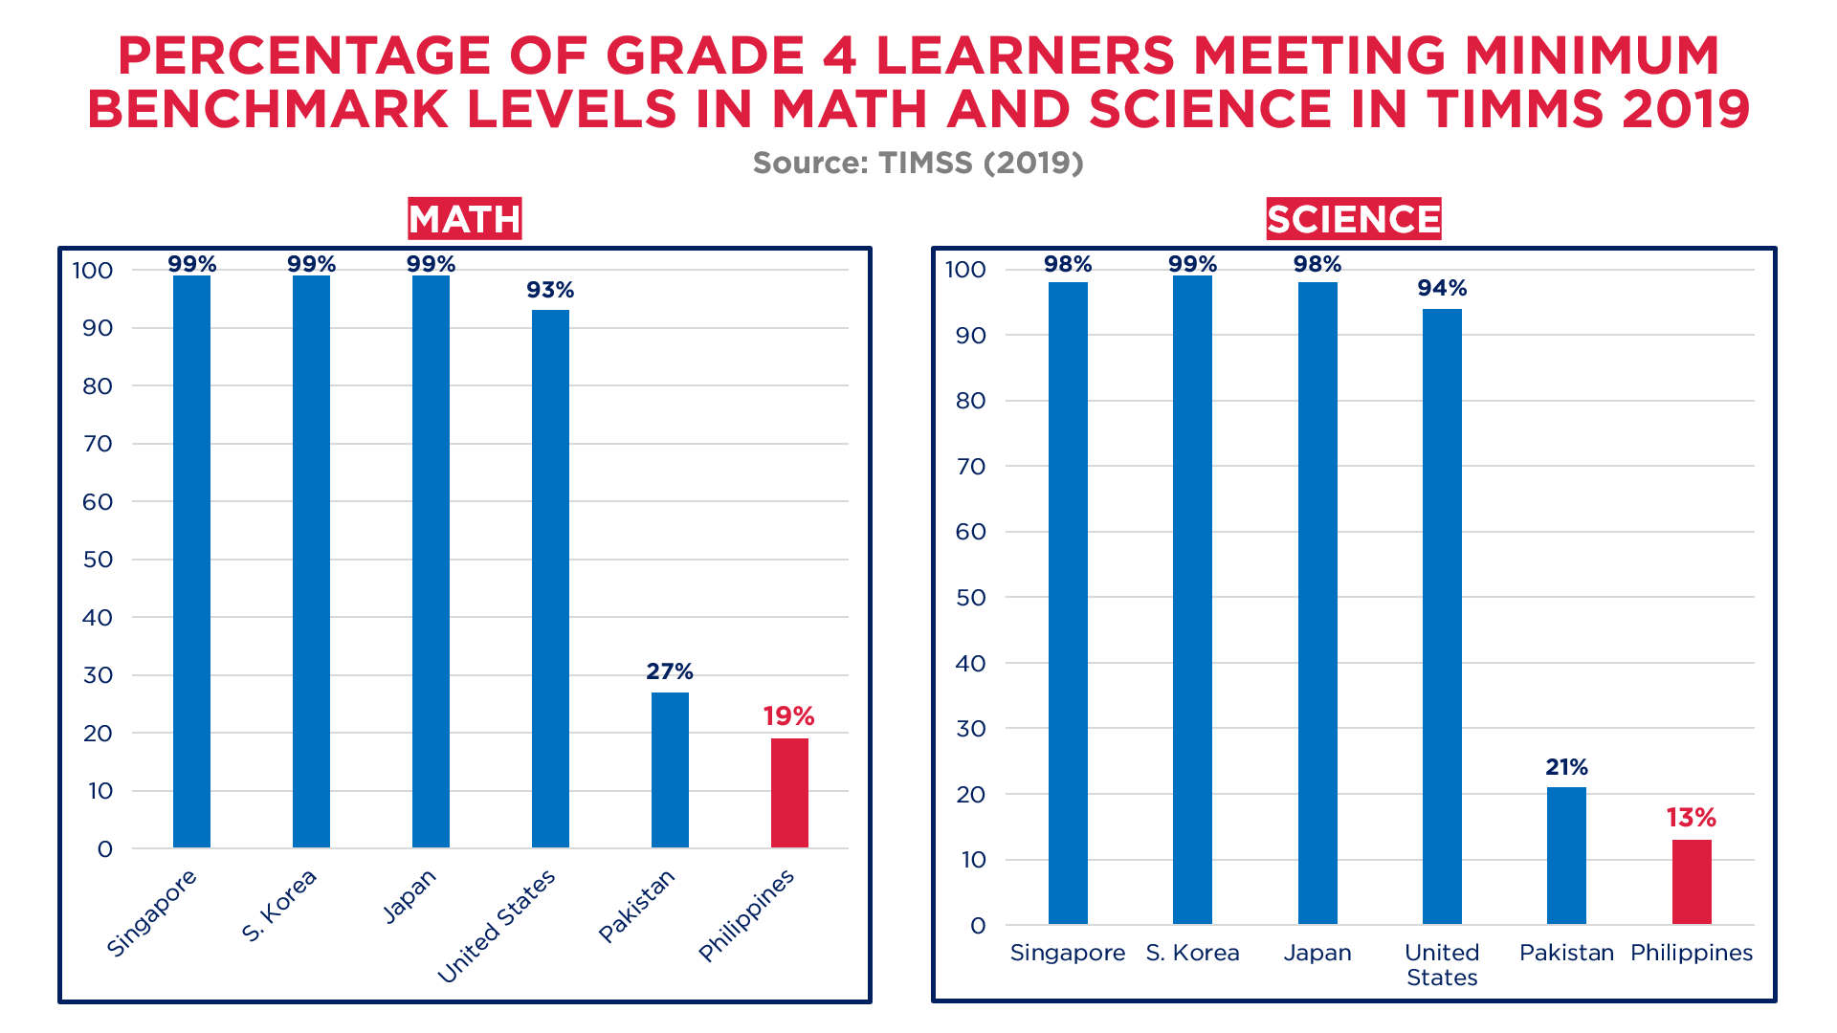

Slide 3
SCHOOL CLOSURES IN THE PHILIPPINES VS OTHER COUNTRIES
Source: UNESCO Institute of Statistics; OSSTG
PHILIPPINES VS. ASEAN + SELECTED ASIAN COUNTRIES
TOP 10 COUNTRIES WITH THE GREATEST NUMBER OF FULL SCHOOL CLOSURES

Slide 4
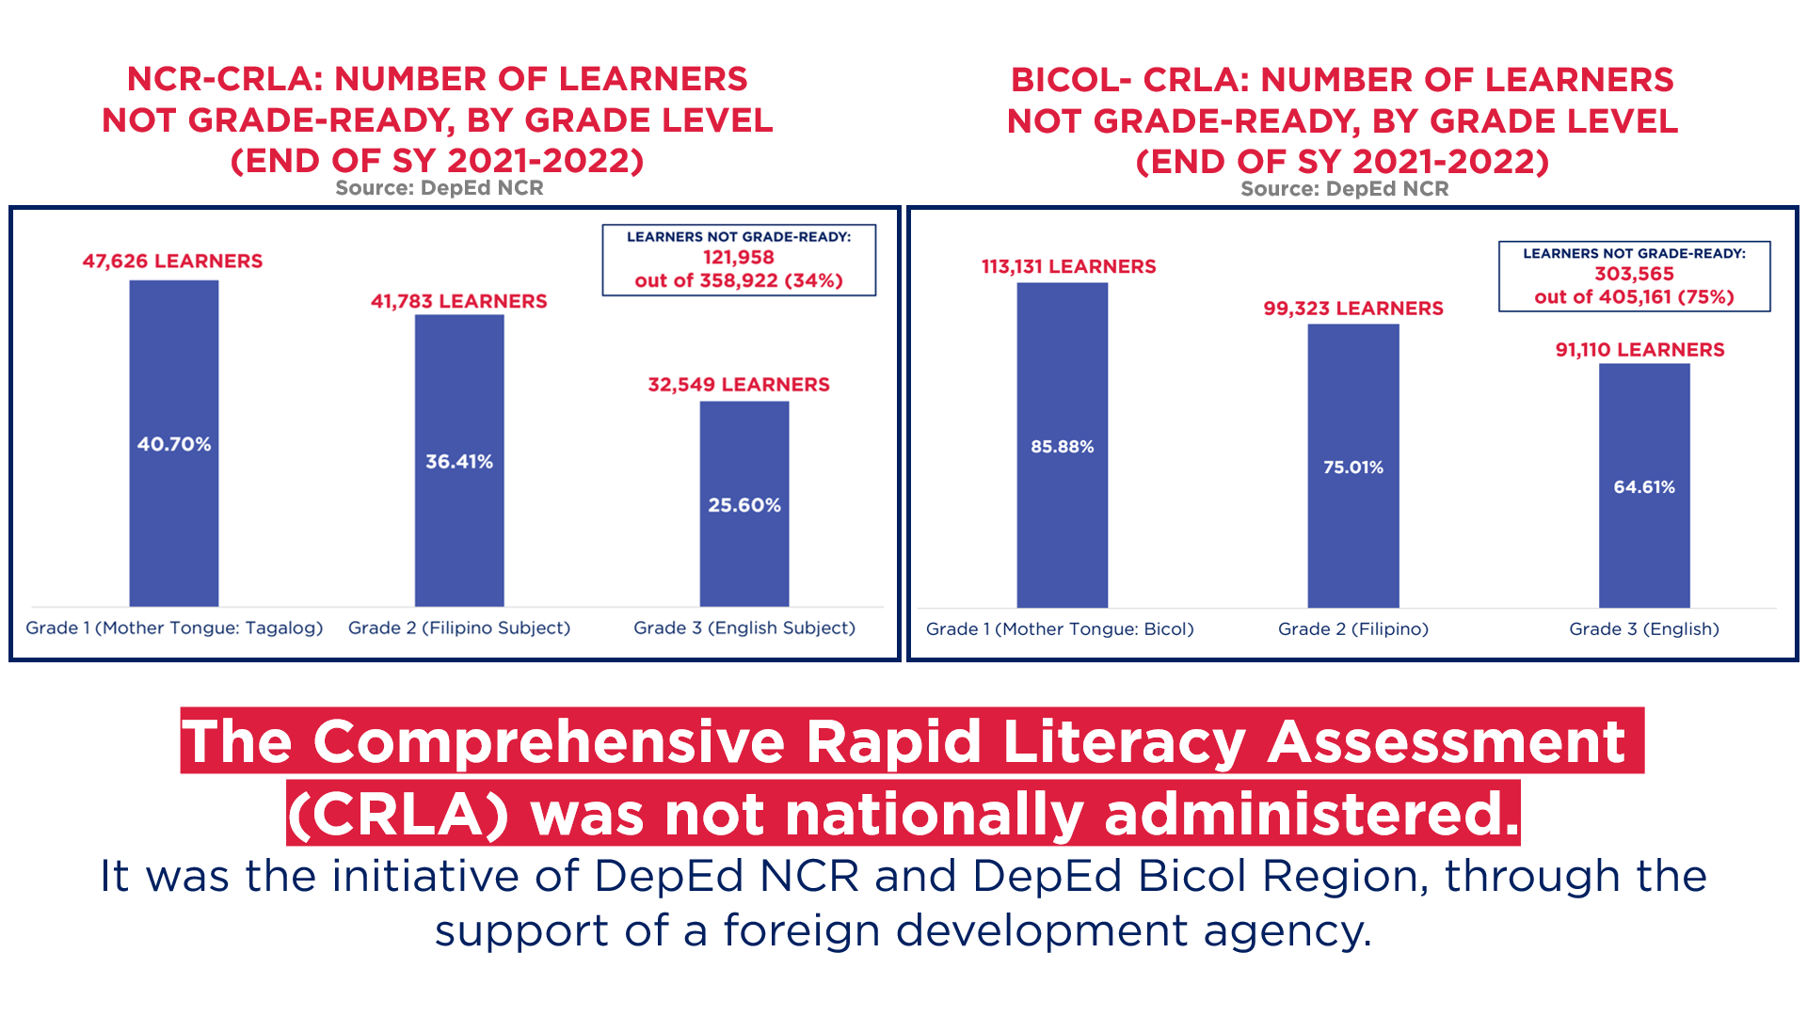
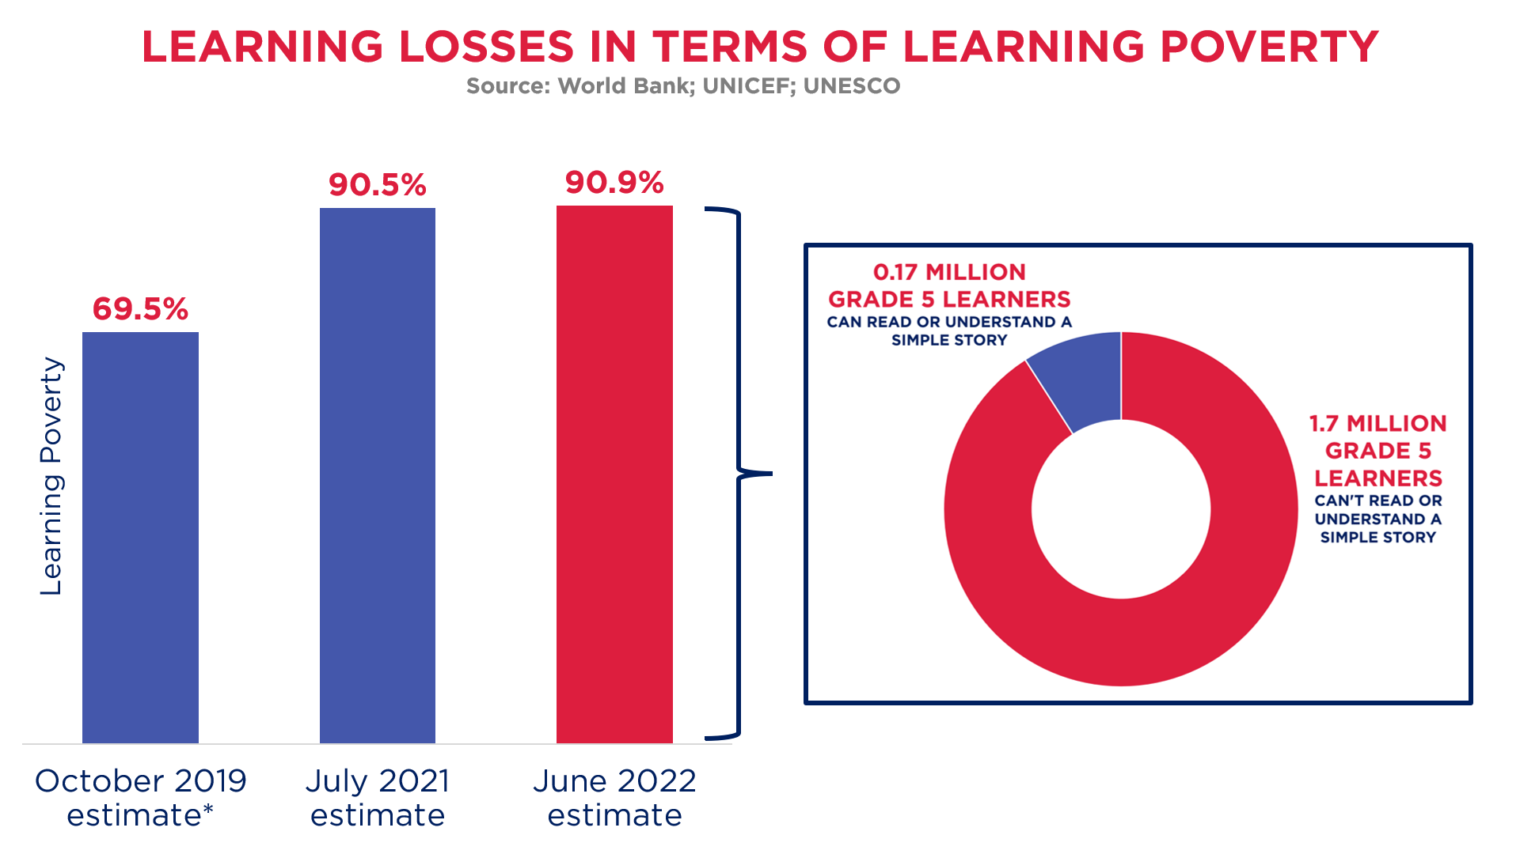
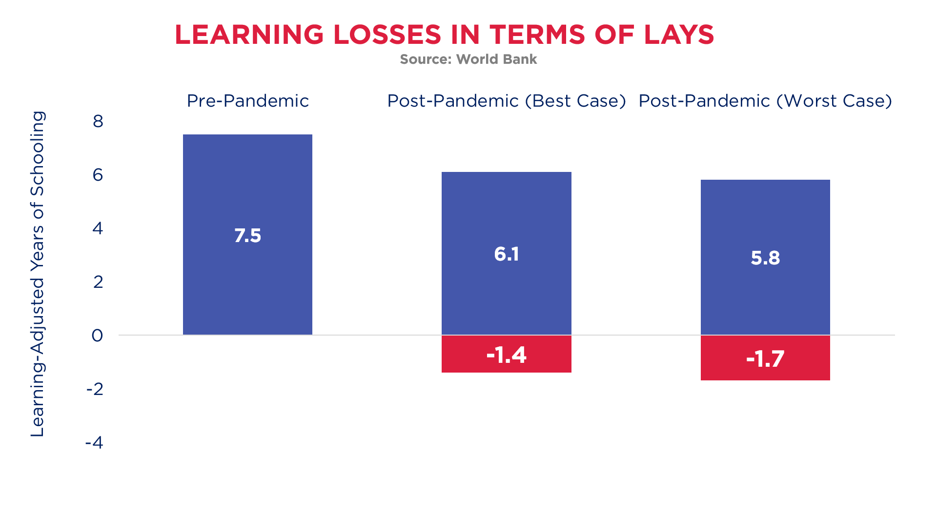
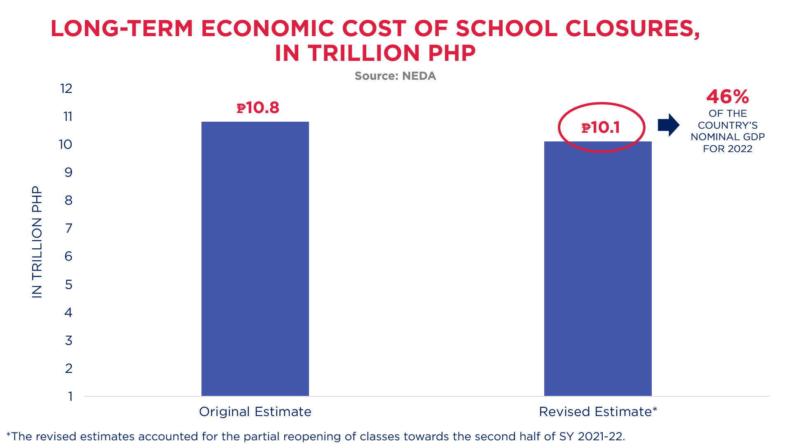

Slide 5
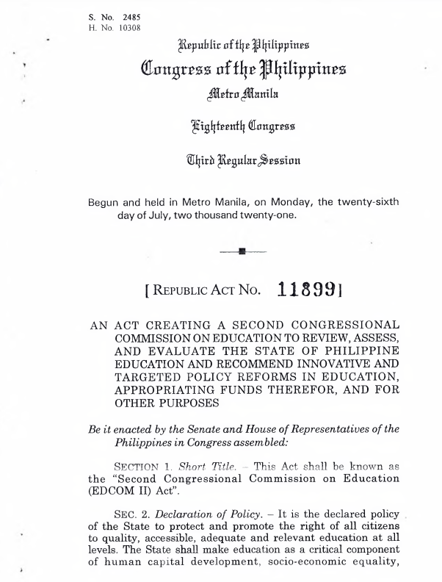
REPUBLIC ACT NO. 11899
THE SECOND CONGRESSIONAL COMMISSION ON EDUCATION
EDCOM II must be implemented to holistically address human capital development, from nutrition, early childhood education, up to formal education and continuing professional development.

Slide 6
PRIORITY ISSUES IDENTIFIED BY THE EDCOM 2
ECCD | HIGHER EDUCATION | TVET AND LIFELONG LEARNING
Nutrition and feeding Supply-side factors Demand-side factors Governance and financing of ECCD | Access Efficiency of higher education provision Graduate education, research, and innovation Digital transformation (cross-cutting) Internationalization (cross-cutting) | Needs-based system projecting the demand in workers’ upskilling Industry involvement and investment in upskilling Ensuring quality in the provision of TVET Framework for equivalency and recognition of non-formal and informal learning
BASIC EDUCATION | TEACHER EDUCATION AND DEVELOPMENT | GOVERNANCE AND FINANCE / CROSS-CUTTING CONCERNS
Learning resources Measurement of learning outcomes Curriculum and instruction Infrastructure ALS Home and school environment | Alignment of CHED, PRC, DepEd, and TEC on teacher education and development Pre-service education In-service training and development | Seamless and integrated delivery of education Public-private complementarity Integrated performance management and accountability system Education financing and resource mobilization Decentralization, quality of education governance Connectedness of learner pathways throughout the system

Slide 7
THE SECOND CONGRESSIONAL COMMISSION ON EDUCATION II (EDCOM II)
LIST OF RELEVANT PRIORITIES AND ISSUES FOR THE DEPARTMENT OF EDUCATION (DEPED)
LEARNING RESOURCES
ISSUES | SPECIFIC TOPICS
Textbook development, production, and distribution | On textbooks Process for evaluation and selection of providers, quality assurance, and distribution Budget allocation and utilization Issues and challenges On DepEd teaching and learning materials (e.g., modules, teacher guides) Process for development, quality assurance, and distribution Budget allocation and utilization Issues and challenges Involvement of LGU and external partners
Using media to enhance language learning | Specific programs and/or campaigns related to the use of mass media for learning, especially K to 6 Adoption of technology mediated learning resources

Slide 8
THE SECOND CONGRESSIONAL COMMISSION ON EDUCATION II (EDCOM II)
LIST OF RELEVANT PRIORITIES AND ISSUES FOR THE DEPARTMENT OF EDUCATION (DEPED)
MEASUREMENT OF LEARNING OUTCOMES
ISSUES | SPECIFIC TOPICS
Adequacy of the assessment system to track learners’ progress and inform system reforms | Updates on the most recent rounds of national assessments, including: Process of development Coverage (with sample items, if possible) Timeline Of administration Modality Number of test-takers and passers Any issues encountered on the implementation Plans for future assessment cycles Policies and guidelines related to data-sharing , particularly for assessment-related data
Reporting and utilization of assessment results for improving learning outcomes

Slide 9
THE SECOND CONGRESSIONAL COMMISSION ON EDUCATION II (EDCOM II)
LIST OF RELEVANT PRIORITIES AND ISSUES FOR THE DEPARTMENT OF EDUCATION (DEPED)
CURRICULUM INSTRUCTION
ISSUES | SPECIFIC TOPICS
Medium/language of instruction | Directions of the department on the language policy, including results of any ongoing consultations and research
Validation of the revised K to 10 (eventually, 11 and 12) curriculum towards decongestion, encouraging flexibility and innovation, and reviewing the spiral curriculum | Updates on the revised curriculum
Learning loss recovery | Updates on programs and plans for learning loss recovery

Slide 10
THE SECOND CONGRESSIONAL COMMISSION ON EDUCATION II (EDCOM II)
LIST OF RELEVANT PRIORITIES AND ISSUES FOR THE DEPARTMENT OF EDUCATION (DEPED)
SCHOOL INFRASTRUCTURE
ISSUES | SPECIFIC TOPICS
Inventory of facilities (public and private) | Updates on and plans related to: Last mile schools Schools that are most frequently exposed to natural disasters Schools that have high levels of congestion
Strategies to address the gaps

Slide 11
THE SECOND CONGRESSIONAL COMMISSION ON EDUCATION II (EDCOM II)
LIST OF RELEVANT PRIORITIES AND ISSUES FOR THE DEPARTMENT OF EDUCATION (DEPED)
ALTERNATIVE LEARNING SYSTEM
ISSUES | SPECIFIC TOPICS
Access and delivery | Profile of learners (level, location, numbers vis-a-vis data on out of school youth) Updates on the availability of community learning centers Results of recent A&E exams/portfolio assessments Tracking of completers
Curriculum content, quality, and assessment, towards preparing learners for employment

Slide 12
THE SECOND CONGRESSIONAL COMMISSION ON EDUCATION II (EDCOM II)
LIST OF RELEVANT PRIORITIES AND ISSUES FOR THE DEPARTMENT OF EDUCATION (DEPED)
HOME AND SCHOOL ENVIRONMENT
ISSUES | SPECIFIC TOPICS
Safe, secure, conducive and supportive learning environment | Updates on the anti-bullying programs (pursuant to the Anti-bullying Act) Updates on programs and/or policies related to improving a safe and secure learning environment
Improved mechanisms for partnerships and shared accountability between families, schools, and communities

Slide 13
THE SECOND CONGRESSIONAL COMMISSION ON EDUCATION II (EDCOM II)
LIST OF RELEVANT PRIORITIES AND ISSUES FOR THE DEPARTMENT OF EDUCATION (DEPED)
ALIGNMENT OF CHED, PRC, DEPED (INCLUDING TEC) ON TEACHER EDUCATION AND DEVELOPMENT
ISSUES | SPECIFIC TOPICS
Harmonization of frameworks among education sector agencies | Establishment of a common framework or common policies to be used by CHED, PRC, and DepEd on teacher education and development, teacher standards Clear delineation of roles and division of labor in the teacher development pipeline Alignment and matching of HEI’s, TEI’s curriculum from DepEd’s teacher standards (PPST) through CHED’s supervision The alignment of LET (supervised by PRC) to DepEd’s teacher standards (PPST)
Extent of alignment of TEIs and HEIs quality
Revisiting Licensure Exam for Teachers (LET)

Slide 14
THE SECOND CONGRESSIONAL COMMISSION ON EDUCATION II (EDCOM II)
LIST OF RELEVANT PRIORITIES AND ISSUES FOR THE DEPARTMENT OF EDUCATION (DEPED)
PRE-SERVICE EDUCATION
ISSUES | SPECIFIC TOPICS
Gaps in pre-service training | Identifying gaps in pre-service training in terms of quality of curriculum, teacher educators, facilities and learning environment, learning pedagogies, and student intake Indicators of quality in teacher education Monitoring of TEI quality Mechanism or process regarding the TEIs who are underperforming (LET passer rate) The profile of students who take up Education in college. Identifying their motivation/s for taking up Education To encourage more students to enter the teaching profession to have a more diverse pool
Quality of Teacher Education Institutions
Encouraging more students to enter the teaching profession
Licensure Exam for Teachers (LET)/licensing of teachers | Analysis of LET content to ensure appropriateness in measuring teacher competencies Data: The predictive power of the LET in terms of teacher behavior and career progression (To determine whether there is a positive relation between pre-service/LET and in-service performance; to provide a content analysis of the LET; to identify measures of teacher quality/outcome) Exploring different models for licensing of teachers (e.g. The licensing of teachers who are going to work within the ALS framework)

Slide 15
THE SECOND CONGRESSIONAL COMMISSION ON EDUCATION II (EDCOM II)
LIST OF RELEVANT PRIORITIES AND ISSUES FOR THE DEPARTMENT OF EDUCATION (DEPED)
IN-SERVICE TRAINING AND DEVELOPMENT
ISSUES | SPECIFIC TOPICS
Teacher welfare | The appropriate school staffing so teachers can perform their teaching duties (teaching to non-teaching ratio) The available data on PD programs for teachers/school heads: The DepEd in-service training programs available and their alignment with the teachers’ PD needs Update on the implementation of PD programs (especially 21st century skills and formative assessment) How teachers are trained to address learner problems The remediation approaches teachers are equipped with The continuing education pathways for teachers Updates on the IRR of the Teacher Education Council
Training and development of teachers and school heads

Slide 16


